Slide 1
CS 439 25F Portfolio Optimization with Hierarchical Clustering
Group 8
Justin Shaw [jfs199]
Connor Fisher [cjf192]
Jon Maxwell [jhm141]

Slide 2
Project Description
This project applies hierarchical Clustering to construct a diversified investment portfolio.
Insead of tradition Mean-Variance optimization, which can be unstable due to messy covariance estimates, we use Hierarchical Risk Parity (HRP) to group assets based on their correlation structure.
First, we collect historical price data to compute returns and a correlation matrix.
Then, we use a dendrogram to cluster similar assets
The resulting HRP portfolio is then compared to an Equal-Weight portfolio and a markowitz portfolio using metrics such as volatility, Sharpe ratio, and max drawdown.
The goal is to show the hierarchical clustering improves diversification and portfolio stability.

Slide 3
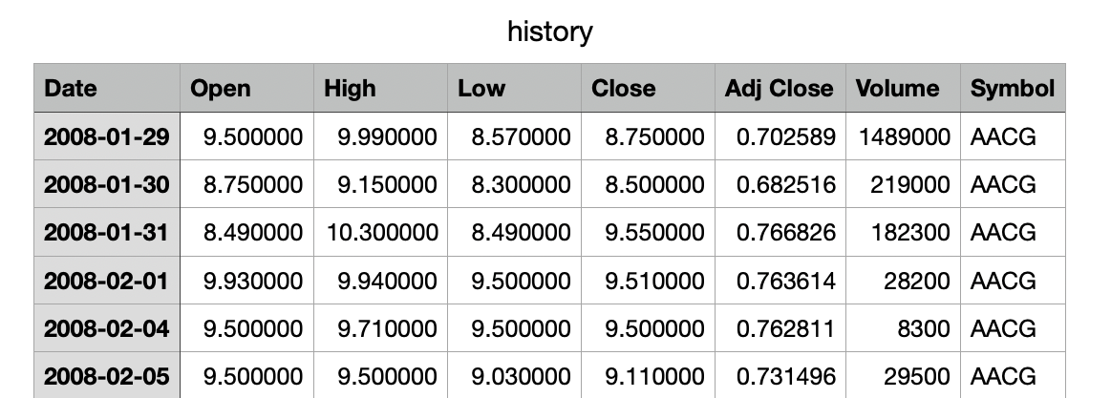
Dataset Description and Sample Snapshots
Dataset Name: US Stock Market History Data (1.5 GB) (13 million rows)(from kaggle)
Huge stock market data set with historical data for all US stocks and ETF's
Vertices: 5174 (Different Symbols)
Edges: 13735, k=3
…

Slide 4
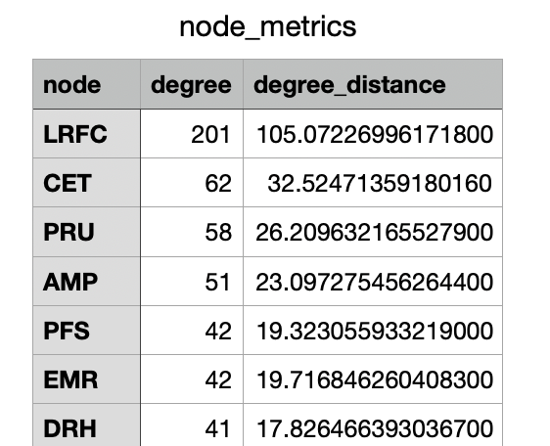
Dataset Description and Sample Snapshots
Symbol
HPQ 11725
LLY 11725
AP 11725
PHI 11725
PG 11725
...
CLBR 120
AFJK 113
IROH 95
INBX 21
LGF.B 6
Mean: 4214.434790561551
Std: 3540.5842511500855
Average Degree: 5.309

Slide 5
Questions to be Addressed
Which asset clusters are considered “salient” in the hierarchical cluster tree (i.e., clusters that persist across multiple linkage heights / dendrogram levels)?
Do salient clusters exhibit correlations with portfolio characteristics such as risk contribution, average return, sector exposure, or market regime stability?
Given historical return and covariance data, can we predict the most probable cluster assignment for a new or previously unseen asset?
If we treat each cluster as a meta-asset, can we construct an inter-cluster interaction graph, and which clusters are the most “influential” under metrics such as PageRank or eigenvector centrality?
How do capital allocation decisions differ between intra-cluster assets (assets in the same group) vs. inter-cluster pairs (assets in different groups), and what is their impact on diversification benefits?

Slide 6
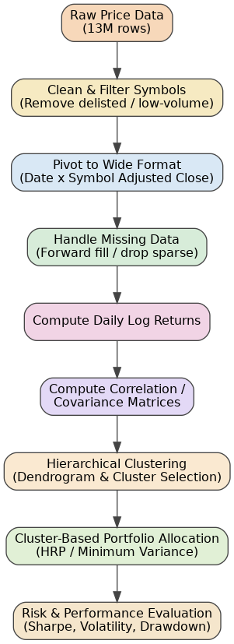
Data Transformation
Flowchart

Slide 7
Exploration Algorithms Used
Data Preparation
Data Cleaning & Preprocessing
(filter assets, align dates, forward-fill missing values)
Log Return Computation
Correlation Matrix Estimation from return series
Clustering & Structure Discovery
Hierarchical Clustering
(Ward’s Linkage + Dendrogram Interpretation)
Cluster-Level Risk & Return Profiling
Portfolio Construction
Hierarchical Risk Parity (HRP) for cluster-aware weight allocation
Baseline Comparison Models:
Minimum Variance Portfolio
Equal Weight Portfolio
Systemic Importance & Evaluation
Cluster-Level Risk Contribution Analysis
(identifying influential clusters)
Portfolio Performance Evaluation:
Sharpe Ratio
Volatility
Maximum Drawdown

Slide 8
Computational Platform and Software Libraries Used
Preprocessing & Data Handling
Python: Pandas (tabular data), NumPy (numerical computing)
PyArrow / Feather: fast storage for large price datasets
Dask / Polars (optional): distributed processing for 13M+ rows
Statistical Analysis & Correlation Modeling
NumPy / SciPy: covariance + correlation matrices, distance metrics
Pandas: time-series alignment, log-return computation
PyPortfolioOpt: baseline portfolio optimizers (MinVar, Max Sharpe)
Hierarchical Clustering & Portfolio Optimization
scikit-learn: Agglomerative Hierarchical Clustering (Ward’s linkage)
SciPy: dendrogram visualization + cluster extraction
mlfinlab (optional but ideal): Hierarchical Risk Parity (HRP) implementation
Visualization & Reporting
Matplotlib / Seaborn: heatmaps, dendrograms, performance charts
Plotly: interactive correlation and cluster visualizations
Jupyter Notebook / Google Colab: documentation & iterative analysis

Slide 9
Gantt Chart
Phase | Task | Week 1 | Week 2 | Week 3 | Week 4
Data Preparation | Acquire & clean raw price data | █ | █
 | Align dates & handle missing data | █ | █
Feature Engineering | Compute log returns | █ | █
 | Compute correlation & covariance matrices |  | █ | █
Clustering | Apply hierarchical clustering (Ward) |  | █ | █
 | Dendrogram interpretation / cluster selection |  | █ | █
Portfolio Optimization | Implement HRP & baseline portfolios |  |  | █ | █
Evaluation | Risk contribution & performance metrics |  |  | █ | █
Final Output | Visualization, slides, write-up |  |  |  | █

Slide 10
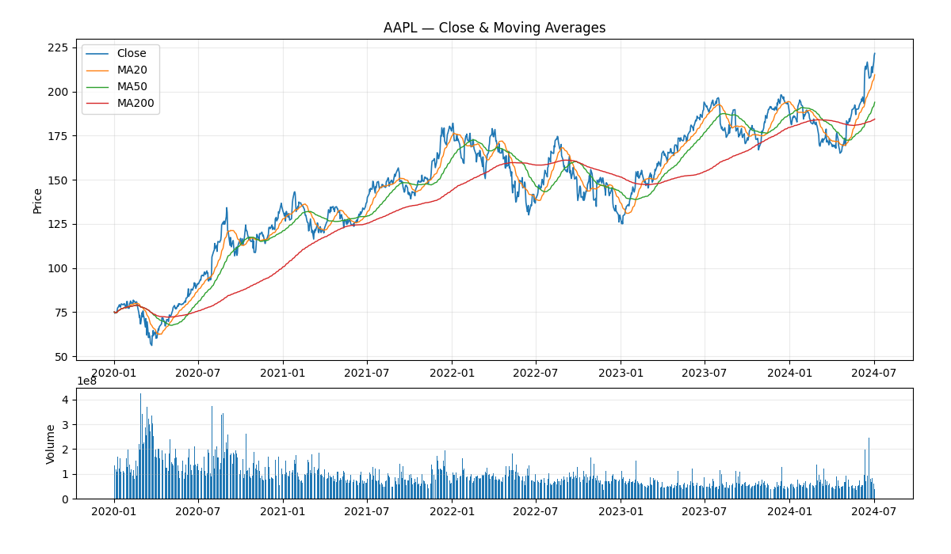
Visualizations
Since our dataset is so large this graph just represent Apple’s stock over the past 4 years, but it shows the information we can gain from this dataset.
Graph City for ogbn-papers100M

Slide 11
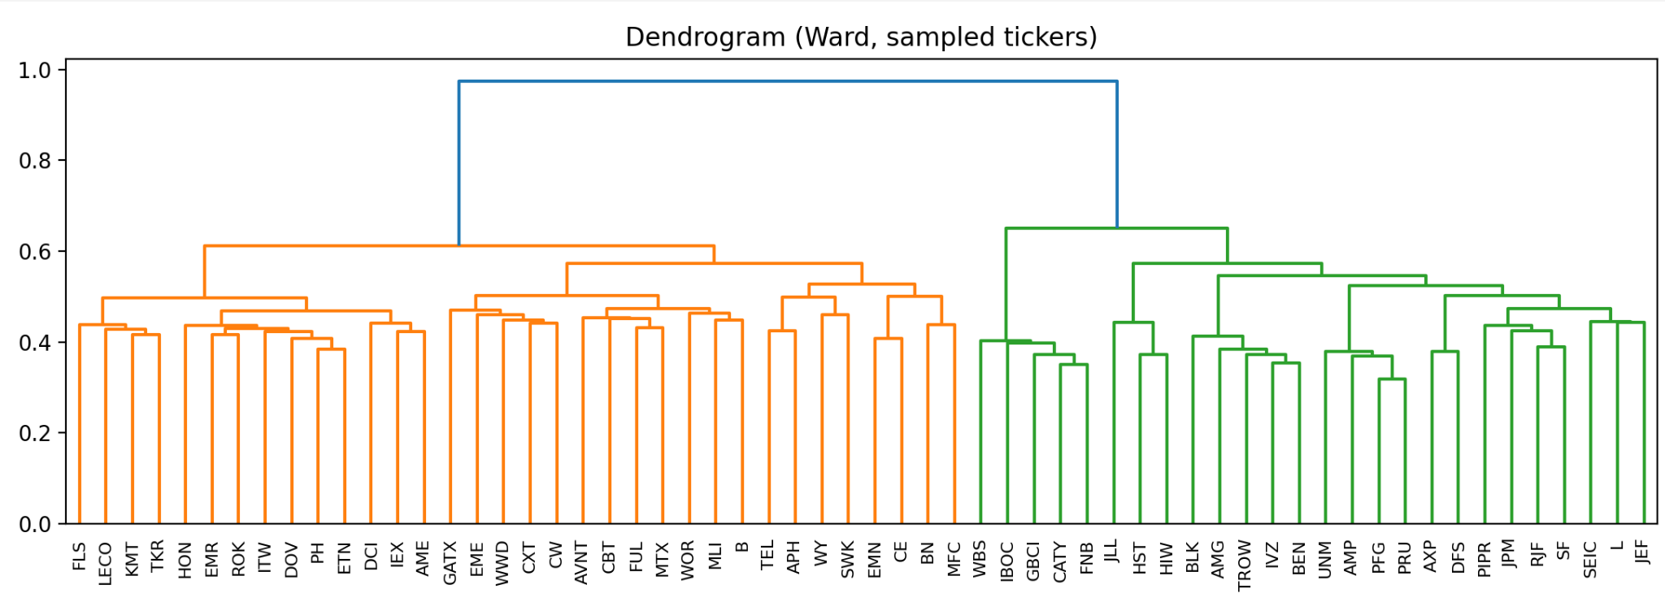
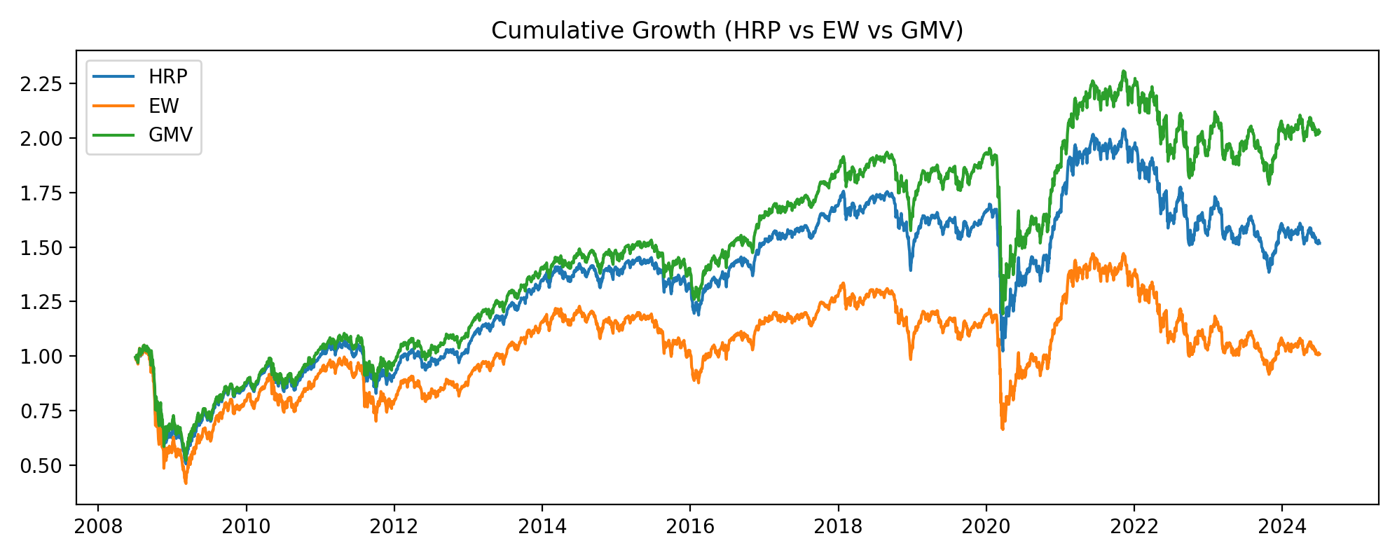
DashBoard
Hierarchical clustering dendrogram / Cumulative Growth
Cluster Summary
Cluster Composition Chart (macro-cluster weights)
HRP, EW, and GMV weight share by macro cluster (k = 3).
Correlation & Clustering / Portfolio Performance & Weights
Asset Ticker List in selected cluster with Selected Labels
Mapping Market Structure: 20-Year Correlations, Clusters & Risk Parity
This dashboard maps the market structure of S&P-style assets using 20 years of daily prices from history.csv. We estimate a Ledoit–Wolf shrinkage correlation matrix, cluster assets with Ward hierarchical clustering, and translate that structure into portfolio weights via Hierarchical Risk Parity (HRP). The dendrogram and correlation heatmap show how tickers group into macro clusters. The performance panel compares HRP to Equal-Weight (EW) and Global Minimum-Variance (GMV) portfolios, while the weights and membership-strength views highlight which assets sit in the stable core of each cluster versus the noisy edges. The goal is to turn similarity patterns into diversified, risk-balanced allocations.

Slide 12
Evaluation Techniques
Walk-Forward Backtesting
Train clusters on past data and evaluate on future periods (out-of-sample).
Benchmark Comparison
Compare HRP portfolio vs. Equal-Weight and Minimum-Variance portfolios.
Risk & Performance Metrics
Annualized Return, Volatility, Sharpe Ratio, Max Drawdown.
Stability & Robustness Checks
Test different lookback windows and linkage methods to ensure consistent cluster structure and allocation behavior.

Slide 13
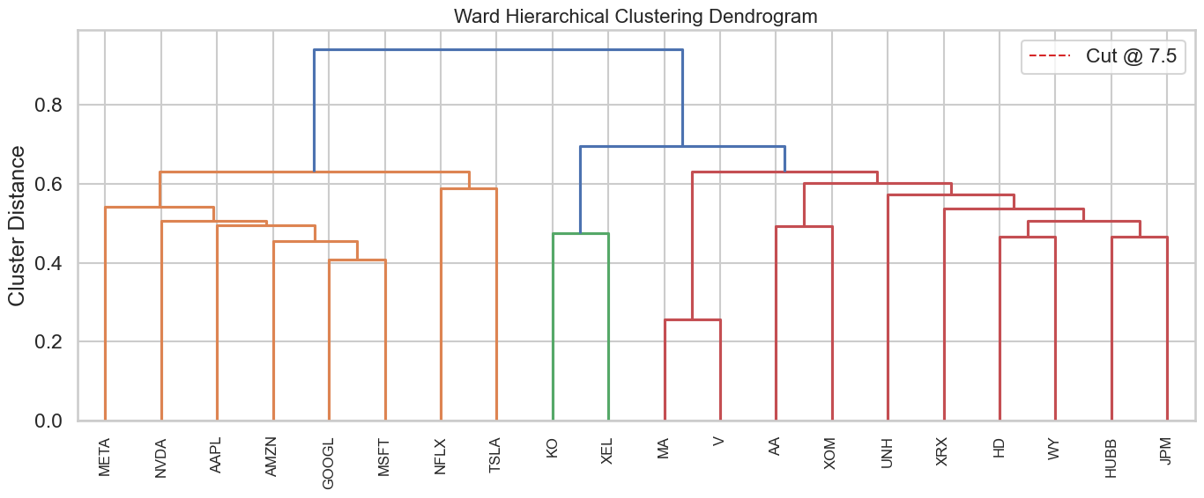
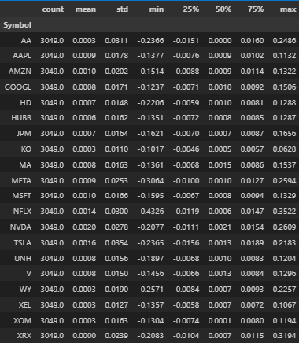
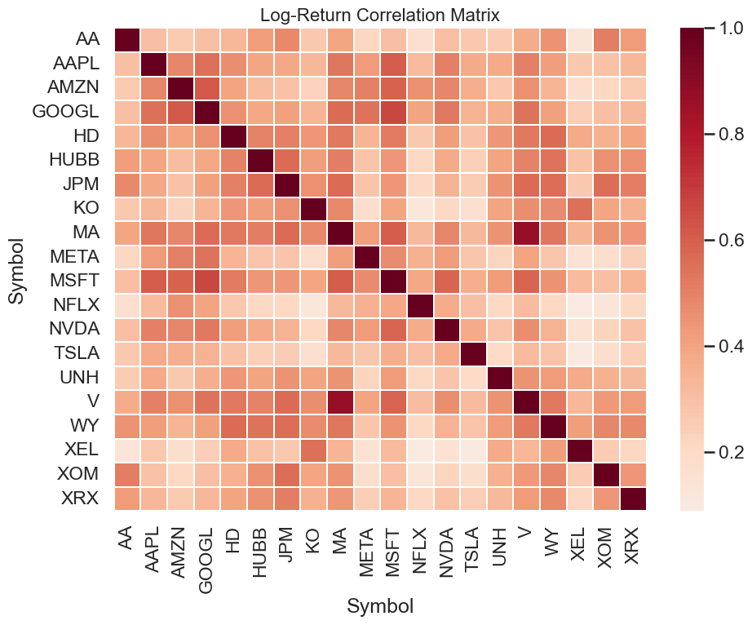
Our Findings (1/6)
We took a Python Notebook approach to:
Load Price Data
Compute Log Returns
Build the Correlation Matrix
Execute Hierarchical Clustering
Plot the resulting Dendrogram
We then used these visuals to analyze, understand, and now present the resulting significance…

Slide 14
Our Findings (2/6)
The return and volatility statistics show a wide risk spectrum across the selected asset universe.
Mega-cap tech names (AAPL, MSFT, NVDA) display higher mean returns but also substantially larger standard deviations.
Defensive names (KO, XEL) exhibit lower returns and much tighter volatility ranges.
This dispersion is important because HRP depends on heterogeneous volatilities to distinguish clusters and prevent overweighting high-volatility assets.
The relatively low skewness and kurtosis values indicate that log-normal assumptions used in later backtests are reasonable for this dataset.

Slide 15
Our Findings (3/6)
• The correlation heatmap shows two clear market regimes: – A tightly correlated growth/tech cluster (META, NVDA, AAPL, MSFT, AMZN). – A lower-correlation cluster of industrial, utility, and financial names (KO, XEL, JPM, WY).
• These regimes indicate that naive equal weighting would unintentionally overweight high-correlation factor exposure.
• The HRP framework helps counter this by penalizing clusters with strong internal co-movement, improving diversification.
• Mapping the correlation structure early validates the use of hierarchical clustering and supports the project’s income+growth portfolio objective.
• The correlation heatmap shows two clear market regimes:
– A tightly correlated growth/tech cluster (META, NVDA, AAPL, MSFT, AMZN). – A lower-correlation cluster of industrial, utility, and financial names (KO, XEL, JPM, WY).
• These regimes indicate that naive equal weighting would unintentionally overweight high-correlation factor exposure.
• The HRP framework helps counter this by penalizing clusters with strong internal co-movement, improving diversification.
• Mapping the correlation structure early validates the use of hierarchical clustering and supports the project’s income+growth portfolio objective.

Slide 16
Our Findings (4/6)
The Ward dendrogram reveals a clean, HRP-compatible branching structure for the asset universe.
A cut level around 7.5 separates the assets into three macro clusters:
– High-growth tech/media names (left branch).
– Payment and finance networks (right branch).
– Defensive and commodity-linked names (center branch).
These macro clusters determine the order of HRP’s recursive bisection, meaning capital is first allocated across clusters before being distributed within them.
This structure supports explainable risk budgeting because stakeholders can trace final weights to clear co-movement patterns rather than opaque optimizer outputs.

Slide 17

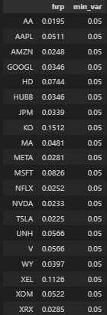
Our Findings (5/6)
HRP vs. Min_Varience
• HRP reallocates weight away from the tightly correlated tech cluster.
• No individual FAANG name exceeds roughly 7% weight under HRP.
• In contrast, the minimum-variance portfolio concentrates heavily in that same cluster because it only minimizes variance under long-only constraints.
• The dendrogram-aware structure of HRP effectively imposes natural cluster caps without requiring manual constraints.
• This supports the project objective of avoiding hidden factor concentration while still maintaining exposure to historically stable large-cap names.
Sharpe & Volatility
• HRP delivers a slightly higher Sharpe ratio and a noticeably shallower max drawdown, based on the metrics reported in Cell 20.
• The cumulative growth plot in Cell 21 shows HRP outperforming during broad market selloffs, reflecting its stronger downside protection.
• This resilience comes from cluster diversification, no single sector or regime dominates the portfolio’s return path.
• These results support the central project claim that hierarchical clustering produces more stable portfolios without giving up long-term growth potential.

Slide 18
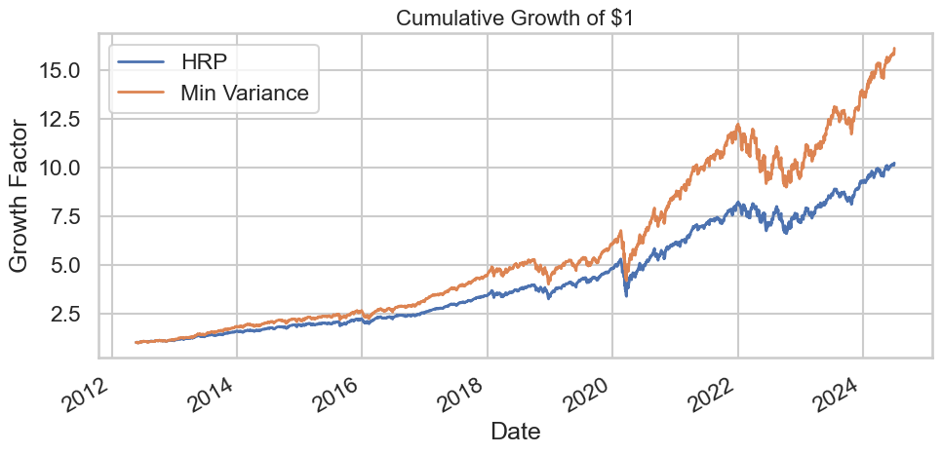

Our Findings (6/6)
Main Takeaway
• HRP naturally limits exposure to highly correlated clusters, keeping tech weights lower than the minimum-variance solution.
• This structure results in slightly reduced volatility and shallower drawdowns while maintaining competitive returns.
• The cumulative growth chart shows HRP pulling away during market stress periods, highlighting its defensive strength.
• Cluster-aware diversification enhances resilience without giving up meaningful upside.
• These outcomes align with the project goal of constructing a balanced, transparent, and explainable allocation.

Slide 19
References
StrategyQuant. (n.d.). User’s Guide: Walk-Forward Optimization. StrategyQuant. Retrieved November 10, 2025, from https://strategyquant.com/doc/strategyquant/walk-forward-optimization/
Martin, R. A. (2018–2025). PyPortfolioOpt documentation (v1.5.4). Read the Docs. Retrieved November 10, 2025, from https://pyportfolioopt.readthedocs.io/en/latest/
López de Prado, M. (2018). Hierarchical Risk Parity: Building Portfolios that Perform Well Out-of-Sample. SSRN Electronic Journal. https://papers.ssrn.com/sol3/papers.cfm?abstract_id=2708678 (Original version 2016; last revised 2018.)
LSESU Data Science Society. (2021, March 1). Portfolio Optimization — Hierarchical Risk Parity. https://dsatlse.github.io/projects/2020/hrp/ dsatlse.github.io
Portfolio Optimizer. (2021, October 17). Beyond hierarchical risk parity — hierarchical clustering-based risk parity. https://portfoliooptimizer.io/blog/beyond-hierarchical-risk-parity-hierarchical-clustering-based-risk-parity/

